Slide 1
Text to image using Gen-Ai
By: Sanjay.B

Slide 2
01.
introduction

Slide 3
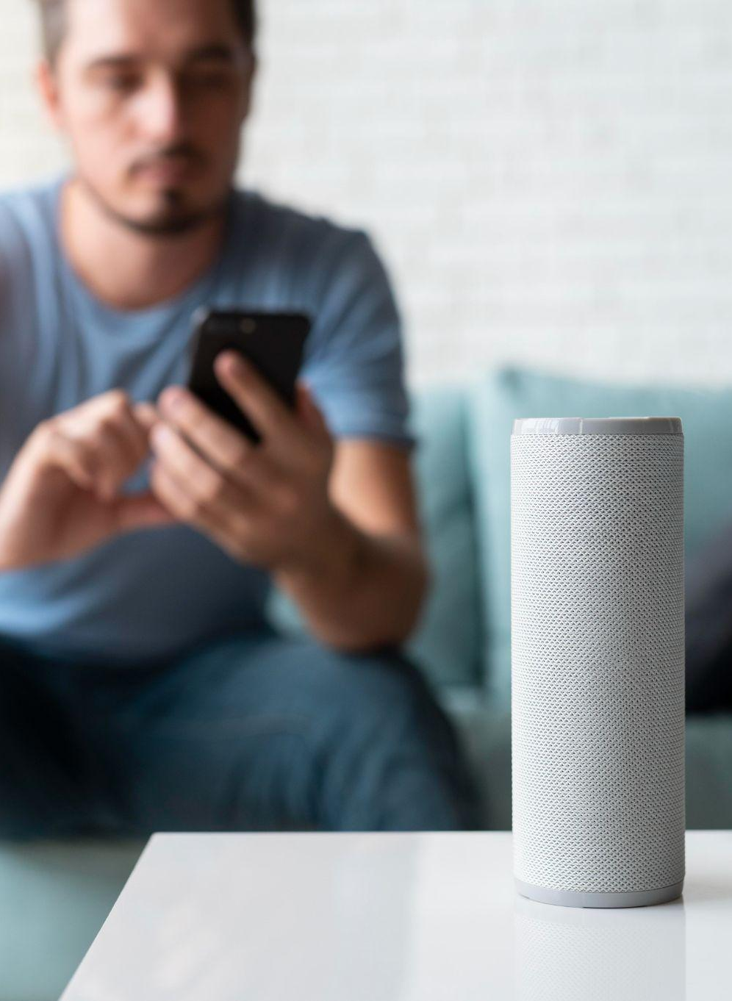
Introduction
In an era where visuals play a pivotal role in communication, the ability to generate images from textual descriptions presents a promising avenue for creative expression, design automation, and content creation.
This project harnesses the power of the DALL-E API alongside Python, Flask, HTML, CSS, and JavaScript to facilitate seamless text-based image generation.

Slide 4
02.
Agenda

Slide 5
Agenda
Problem Statement
Project Overview
End Users
Solution and Value Proposition
The "Wow" Factor
Modeling and Results

Slide 6
03.
Problem statement

Slide 7
Problem Statement
Traditional methods of image creation often require significant time and skill, making them inaccessible to those without specialized training or resources.
Translating textual descriptions into visual representations manually can be time-consuming and subjective.
This project aims to address these challenges by automating the process of generating images from text.

Slide 8
04.
Project Overview

Slide 9
Project overview
Utilizing a combination of Python, Flask, and the DALL-E API, this project provides a user-friendly interface for inputting textual descriptions and receiving corresponding images generated in real-time.
Integration of HTML, CSS, and JavaScript ensures a seamless and interactive user experience.

Slide 10
05.
End user

Slide 11
End user
Graphic designers, content creators, educators, and marketing professionals are the primary end users.
The solution simplifies the image generation process, empowering users to unleash their creativity without specialized skills or software.

Slide 12
06.
Solution and value proposition

Slide 13
Solution and value proposition
Offers a revolutionary approach to image creation by enabling users to translate textual descriptions into visually compelling images effortlessly.
Leveraging the DALL-E API provides access to a vast repository of visual concepts, allowing users to explore limitless creative possibilities.
Streamlines the design process, enhances productivity, and encourages experimentation.

Slide 14
07.
The “wow” factor

Slide 15
The “wow” factor
Ability to accurately capture nuanced textual descriptions and translate them into high-quality, contextually relevant images.
Versatility and precision of the text-to-image generation algorithm impresses users, whether generating creatures from fantastical stories or visualizing abstract concepts.

Slide 16
08.
modeling

Slide 17
modeling
Data Preprocessing:
Clean and format textual descriptions for compatibility with the DALL-E API.
Employ tokenization and normalization techniques for standardization.
Feature Engineering:
Extract relevant features such as keywords and context clues from input text.

Slide 18
modeling
Integration with DALL-E API:
Send processed textual inputs and receive image outputs from the DALL-E API.
Fine-Tuning and Optimization:
Refine model parameters and optimize the text-to-image generation pipeline.
Validation and Testing:
Evaluate model performance using diverse validation datasets.
Ensure robustness and generalization across different contexts.

Slide 19
modeling
Iterative Improvement:
Incorporate feedback from validation and testing to enhance the model.
Continuously monitor performance and user feedback for iterative improvements.
Scalability and Deployment:
Consider scalability and deployment requirements for varying workloads and environments.
Utilize techniques such as containerization and cloud integration for seamless deployment.

Slide 20
09.
Results

Slide 21
Results
Quality Assessment:
Evaluate image quality and relevance to input text using quantitative metrics (SSIM, PSNR) and qualitative assessments.
Performance Evaluation:
Measure computational efficiency, scalability, and responsiveness of the model.
Comparison with Baselines:
Compare model performance against baseline methods in terms of image quality, diversity, and relevance.

Slide 22
Results
User Feedback and Satisfaction:
Gather user feedback through surveys and usability tests to assess satisfaction and usability.
Real-World Applications:
Demonstrate practical applications in content creation, design automation, and personalized image generation.
Future Directions:
Identify areas for further research and development to enhance capabilities and address limitations.

